Slide 1
Android Trends
Shafiul Hasan

Slide 2
Why mobile platforms ?
Mobile is the latest trends.
Desktop is dying .
Web is boring.
Mobile is the buddy.
Mobile is the future.
Mobile development is challenging.
Mobile/tablets will swipe the old heavy desktop/laptops.
Mobile is fun .

Slide 3


Different mobile platfroms.
IOS
Android

Slide 4


Windows
Black Berry

Slide 5

Native vs WebApps
Native
Web Apps
Strong.
Performance.
Uniform UI.
Security.
Power efficient.
More native.
It is like Witch (some times beautiful, ugly when you discover them)

Slide 6

Why android …?
Please tell me why you all wants to be android developer ?

Slide 7



Some problems asusual
** One thing I must warn you, android development is pain in the ass some times
** If you wants to freelance then it has more competitions then other projects.
** Google play is still unavailable in Bangladesh.
for creating accounts :(.

Slide 8
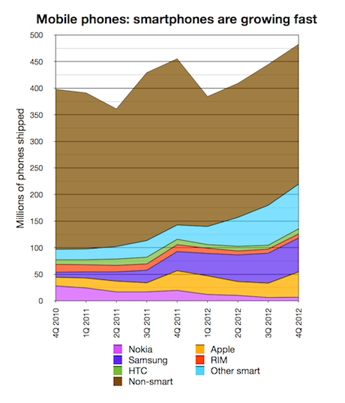
Smart phones numbers

Slide 9
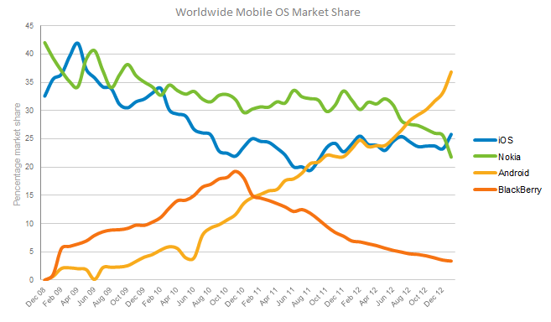
Mobile market share

Slide 10

Some Inspiring Statics.

Slide 11
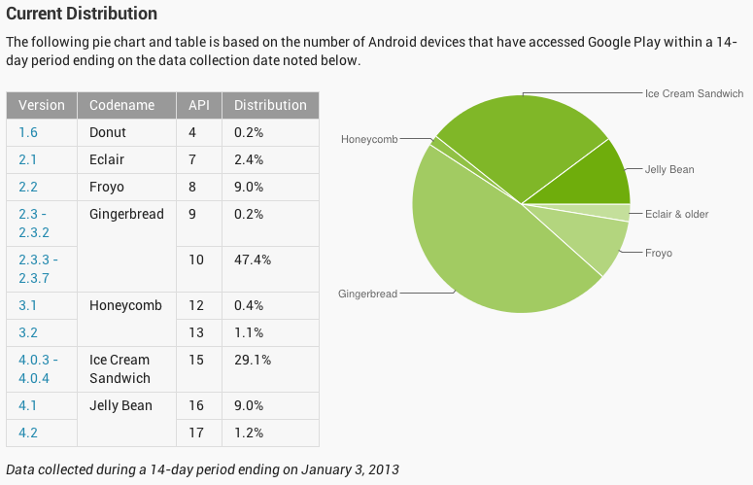
Android’s version map

Slide 12
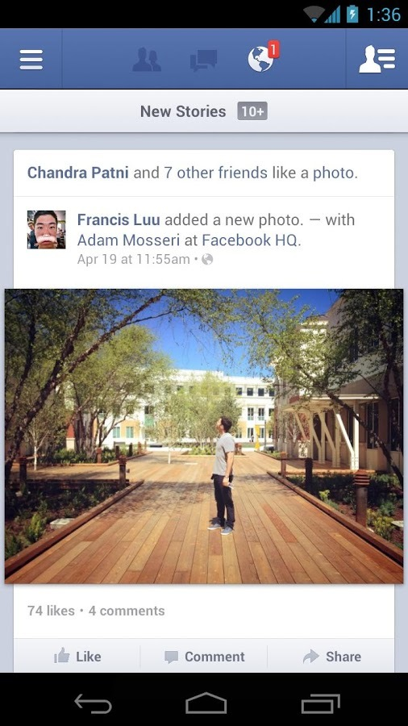

Some mostly downloaded apps
Facebook

Slide 13
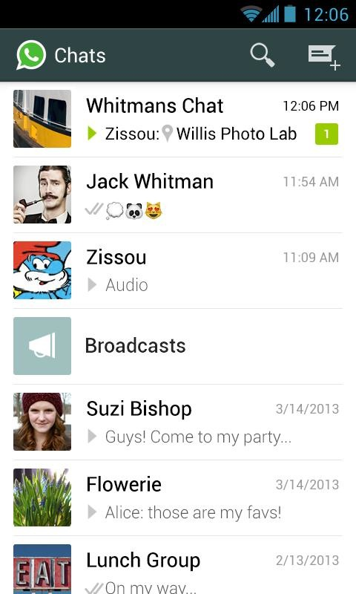
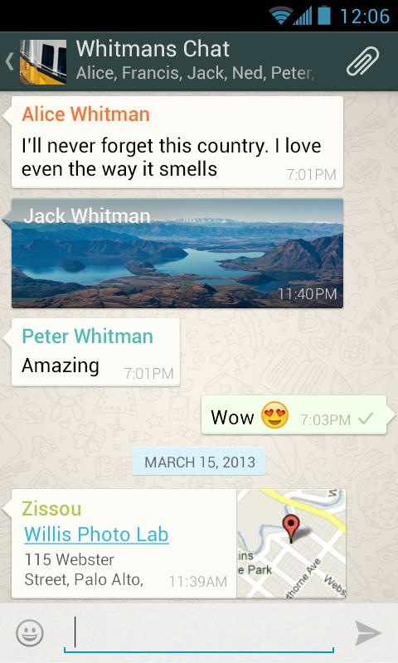
Whats App Messenger.

Slide 14
When will we build something like these apps ?
If ( countHortalsInLastTwoYears()== 0 ){
// Impossible condition , so it will be never executed.
throw new Exception(“Impossible condition executed. ”);
}

Slide 15
Any questions ?
Please do not ask any question now, I need a 5 minutes break now ☺.

Slide 16
Android Application Development
Shafiul Hasan

Slide 17
Course Summary
Android is unlike any other mobile development platform or Java-based environment. This training will immerse students in the Android platform,
leveraging their existing Java expertise, and allowing them to walk away
from the class ready to build Android GUIs and related components.
This hands‐on course encourages the trainees to learn by building increasingly more sophisticated and meaningful mobile applications for AndroidTM through the approach of learning by examples and small tutorials along with explanations of underlying mechanisms.
This course does not include any material’s for the platform developers.
This course is designed for only application developers.
This course will not cover all the advanced features for application development, rather it will provide trainees a guideline on how to learn and implement more advanced tropics .

Slide 18



Course Objectives
$$$$$ ☺ ?.
Any of these …?
NOPE : Our main objectives is to build couple of thousands good, robust, skilled
Android developers, So that Bangladesh will be the main destination to make
Quality apps . We want to build some android geeks ☺

Slide 19
Course Duration
Course is divided into 3 sections :
Basics of Android developments (5-6 lessons).
Basics of Java and OOP concepts ( 6-7 lessons ).
Advanced Android tropics (10-12 lessons ).
Future guidelines for self improvements and App Development(1 class).
Course Prerequisites
To Take this course , you must have the following qualities ,
You must have love for programming.
You must know either java or c# , or you are willing to lean it .
You must have the tendency to do your assignments by your selves.
You must have the courage to ask questions in the class. DO NOT BE SHY IN THE CLASS.ASK AS MANY QUESTIONS AS YOU CAN , TRY TO UNDERSTAND EVERY BIT OF THE PRESENTATION.
If you are lazy, then this course is not for you.
You have to love Puzzles, because we will solve lots
of them

Slide 20
Android Basics
Environment setups.
Basic tools understandings.
Basic project structure .
Hello world example.
Activity life cycles.
Familiarization with basic android Widgets.
Class test # AND-01

Slide 21
OOP Basics
User defined type.
Finding objects from problem domain.
What is object and what is class.
Encapsulation.
Constructor.
Refactoring your code.
Method Overloading and constructor overloading.

Slide 22
Static class and method.
Association, composition, aggregation.
Array, Array-List.
Accessibility and scope.
Inheritance, Abstract class and method.
Method overriding and constructor overriding.
Final and static final.
Interface and collections in java.
Exception handling.
Class test # OOP-1

Slide 23
Advanced Android
Layout designs.
Storage and Database.
Web-Services and http requests.
List views, List activity and adapters.
Services, Intents, fragments and dialogs.
Actionbars and viewpagers.
Async tasks, thread and handlers.
GPS and location API.
Maps API.
Class test #AND-2

Slide 24
More Advance Tropics
Deployments.
Licensing.
Camera API.
Sensor API.
Telephone API.
Broadcast Receivers.
Better Practices.
**** These tropics will be covered if time permits, we will provide sample projects, slides, screen-casts for these tropics.

Slide 25
Course Works
Course works is divided into 4 sections :
Assignments.
Class Tests.
Sudden Tests.
Projects.
Course Materials
Course materials could be found from the following sources,
Screen-casts of sessions.
Slides.
Sample projects.
Tutorial videos.
Blog links.
Githhub project links.

Slide 26
Evaluation
There will be no traditional evaluation. You will evaluate yourselves, if
course trainer wants to verify your grade then he might take a viva or a programming
test or a written test to justify, then he will put the final grade.

Slide 27
Tools
Shafiul Hasan

Slide 28
Tools
Eclipse
Android Studio
Jetbrains
Notepad..

Slide 29
Will be update later ……

Slide 30
What is Androidmanifest.xml
The manifest presents essential information about the application to the Android system, information the system must have before it can run any of the application's code.
Every Application must have a AndroidManidest.xml file in it’s root directory.

Slide 31
Facts about Manifest files
It names the Java package for the application. The package name serves as a unique identifier for the application.
It describes the components of the application — the activities, services, broadcast receivers, and content providers that the application is composed of. It names the classes that implement each of the components and publishes their capabilities (for example, which Intent messages they can handle). These declarations let the Android system know what the components are and under what conditions they can be launched.
It determines which processes will host application components.
It declares which permissions the application must have in order to access protected parts of the API and interact with other applications.
It also declares the permissions that others are required to have in order to interact with the application's components.
It lists the Instrumentation classes that provide profiling and other information as the application is running. These declarations are present in the manifest only while the application is being developed and tested; they're removed before the application is published.
It declares the minimum level of the Android API that the application requires.
It lists the libraries that the application must be linked against.

Slide 32
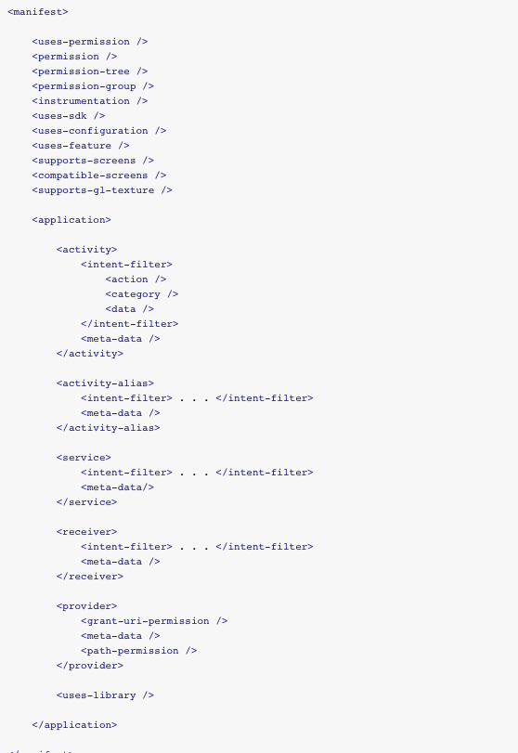
AndroidManifest file components

Slide 33
Components
uses-permission
permission
permission-tree
permission-group
instrumentation
uses-sdk
uses-configuration
uses-feature
supports-screens
compatible-screens
supports-gl-texture
application
Most important one.

Slide 34
Uses permission
Requests a permission that the application must be granted in order for it to operate correctly. Permissions are granted by the user when the application is installed, not while it's running.
Exp :
<uses-permission
android:name="android.permission.WRITE_EXTERNAL_STORAGE"
/>

Slide 35
Instrumentation
Declares an Instrumentation class that enables you to monitor an application's interaction with the system. The Instrumentation object is instantiated before any of the application's components.
<instrumentation android:functionalTest=["true" | "false"]
android:handleProfiling=["true" | "false"]
android:icon="drawable resource"
android:label="string resource"
android:name="string"
android:targetPackage="string" />

Slide 36
Uses-SDK
Despite its name, this element is used to specify the API Level, not the version number of the SDK (software development kit) or Android platform. The API Level is always a single integer. You cannot derive the API Level from its associated Android version number (for example, it is not the same as the major version or the sum of the major and minor versions).
<uses-sdk android:minSdkVersion="integer"
android:targetSdkVersion="integer"
android:maxSdkVersion="integer" />

Slide 37
uses-feature
Declares a single hardware or software feature that is used by the application.
The purpose of a <uses-feature> declaration is to inform any external entity of the set of hardware and software features on which your application depends.
<uses-feature android:name="android.hardware.bluetooth" />
<uses-feature android:name="android.hardware.camera" />
Hardware Features | Software Features
android.hardware.bluetooth | android.software.app_widgets
android.hardware.camera | android.software.home_screen
android.hardware.location | android.software.live_wallpaper
http://developer.android.com/guide/topics/manifest/uses-feature-element.html

Slide 38
supports-screens
An application "supports" a given screen size if it resizes properly to fill the entire screen. Normal resizing applied by the system works well for most applications and you don't have to do any extra work to make your application work on screens larger than a handset device. However, it's often important that you optimize your application's UI for different screen sizes by providing alternative layout resources. For instance, you might want to modify the layout of an activity when it is on a tablet compared to when running on a handset device.
<supports-screens android:resizeable=["true"| “false"] (Do not use this now) android:smallScreens=["true" | "false"]
android:normalScreens=["true" | "false"]
android:largeScreens=["true" | "false"]
android:xlargeScreens=["true" | "false"]
android:anyDensity=["true" | "false"]
android:requiresSmallestWidthDp="integer"
android:compatibleWidthLimitDp="integer"
android:largestWidthLimitDp="integer"/>

Slide 39
uses-library
This element tells the system to include the library's code in the class loader for the package. This element also affects the installation of the application on a particular device and the availability of the application on Google Play,
<uses-library
android:name="string"
android:required=["true" | "false"] />

Slide 40
Application
Describe the whole application
<application android:allowTaskReparenting=["true" | "false"]
android:allowBackup=["true" | "false"]
android:backupAgent="string"
android:debuggable=["true" | "false"]
android:description="string resource"
android:enabled=["true" | "false"]
android:hasCode=["true" | "false"]
android:hardwareAccelerated=["true" | "false"]
android:icon="drawable resource"
android:killAfterRestore=["true" | "false"]
android:largeHeap=["true" | "false"]
android:label="string resource"
android:logo="drawable resource"
android:manageSpaceActivity="string"
android:name="string"
android:permission="string"
android:persistent=["true" | "false"]
android:process="string"
android:restoreAnyVersion=["true" | "false"]
android:requiredAccountType="string"
android:restrictedAccountType="string"
android:supportsRtl=["true" | "false"]
android:taskAffinity="string"
android:testOnly=["true" | "false"]
android:theme="resource or theme"
android:uiOptions=["none" | "splitActionBarWhenNarrow"]
android:vmSafeMode=["true" | "false"] >
. . .
</application>

Slide 41
Components of Application
Activity
Activity ALIAS
Service
Receiver
Provider
Uses-library

Slide 42
Activity
activity android:allowTaskReparenting=["true" | "false"]
android:alwaysRetainTaskState=["true" | "false"]
android:clearTaskOnLaunch=["true" | "false"]
android:configChanges=["mcc", "mnc", "locale",
"touchscreen", "keyboard", "keyboardHidden",
"navigation", "screenLayout", "fontScale", "uiMode",
"orientation", "screenSize", "smallestScreenSize"]
android:enabled=["true" | "false"]
android:excludeFromRecents=["true" | "false"]
android:exported=["true" | "false"]
android:finishOnTaskLaunch=["true" | "false"]
android:hardwareAccelerated=["true" | "false"]
android:icon="drawable resource"
android:label="string resource"
android:launchMode=["multiple" | "singleTop" |
"singleTask" | "singleInstance"]
android:multiprocess=["true" | "false"]
android:name="string"
android:noHistory=["true" | "false"]
android:parentActivityName="string"
android:permission="string"
android:process="string"
android:screenOrientation=["unspecified" | "behind" |
"landscape" | "portrait" |
"reverseLandscape" | "reversePortrait" |
"sensorLandscape" | "sensorPortrait" |
"userLandscape" | "userPortrait" |
"sensor" | "fullSensor" | "nosensor" |
"user" | "fullUser" | "locked"]
android:stateNotNeeded=["true" | "false"]
android:taskAffinity="string"
android:theme="resource or theme"
android:uiOptions=["none" | "splitActionBarWhenNarrow"]
android:windowSoftInputMode=["stateUnspecified",
"stateUnchanged", "stateHidden",
"stateAlwaysHidden", "stateVisible",
"stateAlwaysVisible", "adjustUnspecified",
"adjustResize", "adjustPan"] >

Slide 43
Live AndroidManifest file
<?xml version="1.0" encoding="utf-8"?>
<manifest xmlns:android="http://schemas.android.com/apk/res/android"
package="com.widespace.webviewsdk"
android:versionCode="1"
android:versionName="1.0" >
<uses-sdk
android:minSdkVersion="8"
android:targetSdkVersion="18" />
<uses-permission android:name="android.permission.INTERNET" />
<uses-permission android:name="android.permission.ACCESS_FINE_LOCATION" />
<application
android:allowBackup="true"
android:icon="@drawable/ic_launcher"
android:label="@string/app_name"
android:theme="@style/AppTheme" >
<activity
android:name="com.widespace.webviewsdk.MainActivity"
android:label="@string/app_name" >
<intent-filter>
<action android:name="android.intent.action.MAIN" />
<category android:name="android.intent.category.LAUNCHER" />
</intent-filter>
</activity>
<meta-data
android:name="com.google.android.gms.version"
android:value="@integer/google_play_services_version" />
</application>
</manifest>

Slide 44
Intent
An Intent is a messaging object you can use to request an action from another app component. Although intents facilitate communication between components in several ways, there are three fundamental use-cases:
• To start an activity: An Activity represents a single screen in an app. You can start a new instance of an Activity by passing an Intent to startActivity(). The Intent describes the activity to start and carries any necessary data.
If you want to receive a result from the activity when it finishes, call startActivityForResult(). Your activity receives the result as a separate Intent object in your activity's onActivityResult() callback. For more information, see the Activities guide.
• To start a service: A Service is a component that performs operations in the background without a user interface. You can start a service to perform a one-time operation (such as download a file) by passing an Intent to startService(). The Intent describes the service to start and carries any necessary data.
If the service is designed with a client-server interface, you can bind to the service from another component by passing an Intent to bindService(). For more information, see the Services guide.
• To deliver a broadcast: A broadcast is a message that any app can receive. The system delivers various broadcasts for system events, such as when the system boots up or the device starts charging. You can deliver a broadcast to other apps by passing an Intent to sendBroadcast(), sendOrderedBroadcast(), or sendStickyBroadcast().

Slide 45
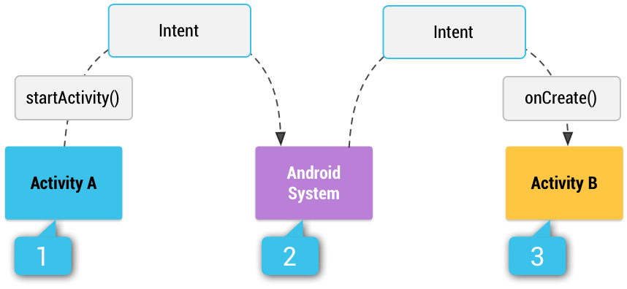
Chart

Slide 46
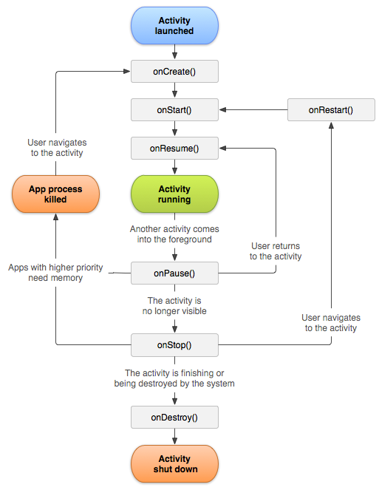
Activity life cycle

Slide 47
Code
public class ActivityLifeCycleTest extends Activity {
@Override
public void onCreate(Bundle savedInstanceState) {
super.onCreate(savedInstanceState);
// The activity is being created.
}
@Override
protected void onStart() {
super.onStart();
// The activity is about to become visible.
}
@Override
protected void onResume() {
super.onResume();
// The activity has become visible (it is now "resumed").
}
@Override
protected void onPause() {
super.onPause();
// Another activity is taking focus (this activity is about to be "paused").
}
@Override
protected void onStop() {
super.onStop();
// The activity is no longer visible (it is now "stopped")
}
@Override
protected void onDestroy() {
super.onDestroy();
// The activity is about to be destroyed.
}
}

Slide 48
Open second Activity through Intent
Intent intent = new Intent(packageContext, SecondAcitivity.class);
startActivity(intent);

Slide 49
Pass Data through Intent
Intent intent = new Intent(packageContext, SecondAcitivity.class);
intent.putExtra(key1, value);
intent.putExtra(key2, value);
intent.putExtra(key3, value);
startActivity(intent);
In the SecondActivity class
Bundle extras = getIntent().getExtras();
if (extras != null) {
String studentName = extras.getString("studentname");
int studentAge = extras.getInt("age");
Boolean isMale = extras.getBoolean("ismale");
}

Slide 50
Layouts
Linear Layout
Relative layout
Table Layout
Frame Layout
Absolute Layout

Slide 51
Linear Layout
Linearlayout aligns all children in a single direction — vertically or horizontally, depending on how you define the orientation attribute. All children are stacked one after the other, so a vertical list will only have one child per row, no matter how wide they are, and a horizontal list will only be one row high (the height of the tallest child, plus padding). A LinearLayout respects margins between children and the gravity (right, center, or left alignment) of each child.

Slide 52

Screenshots

Slide 53
XML
<?xml version="1.0" encoding="utf-8"?>
<LinearLayout xmlns:android="http://schemas.android.com/apk/res/android"
android:layout_width="fill_parent"
android:layout_height="fill_parent"
android:paddingLeft="16dp"
android:paddingRight="16dp"
android:orientation="vertical" >
<EditText
android:layout_width="fill_parent"
android:layout_height="wrap_content"
android:hint="@string/to" />
<EditText
android:layout_width="fill_parent"
android:layout_height="wrap_content"
android:hint="@string/subject" />
<EditText
android:layout_width="fill_parent"
android:layout_height="0dp"
android:layout_weight="1"
android:gravity="top"
android:hint="@string/message" />
<Button
android:layout_width="100dp"
android:layout_height="wrap_content"
android:layout_gravity="right"
android:text="@string/send" />
</LinearLayout>

Slide 54
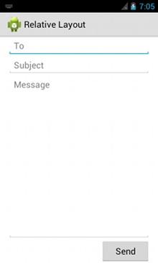
Output

Slide 55
Relative Layout
RelativeLayout lets child views specify their position relative to the parent view or to each other (specified by ID). So you can align two elements by right border, or make one below another, centered in the screen, centered left, and so on. Elements are rendered in the order given, so if the first element is centered in the screen, other elements aligning themselves to that element will be aligned relative to screen center. Also, because of this ordering, if using XML to specify this layout, the element that you will reference (in order to position other view objects) must be listed in the XML file before you refer to it from the other views via its reference ID.

Slide 56

Screenshots

Slide 57
layout Parameters
android:layout_above
Positions the bottom edge of this view above the given anchor view ID.
android:layout_alignBaseline
Positions the baseline of this view on the baseline of the given anchor view ID.
android:layout_alignBottom
Makes the bottom edge of this view match the bottom edge of the given anchor view ID.
android:layout_alignEnd
Makes the end edge of this view match the end edge of the given anchor view ID.
android:layout_alignLeft
Makes the left edge of this view match the left edge of the given anchor view ID.
android:layout_alignParentBottom
If true, makes the bottom edge of this view match the bottom edge of the parent.
android:layout_alignParentEnd
If true, makes the end edge of this view match the end edge of the parent.

Slide 58
android:layout_alignParentLeft
If true, makes the left edge of this view match the left edge of the parent.
android:layout_alignParentRight
If true, makes the right edge of this view match the right edge of the parent.
android:layout_alignParentStart
If true, makes the start edge of this view match the start edge of the parent.
android:layout_alignParentTop
If true, makes the top edge of this view match the top edge of the parent.
android:layout_alignRight
Makes the right edge of this view match the right edge of the given anchor view ID.
android:layout_alignStart
Makes the start edge of this view match the start edge of the given anchor view ID.
android:layout_alignTop
Makes the top edge of this view match the top edge of the given anchor view ID.
android:layout_alignWithParentIfMissing
If set to true, the parent will be used as the anchor when the anchor cannot be be found for layout_toLeftOf, layout_toRightOf, etc.
android:layout_below
Positions the top edge of this view below the given anchor view ID

Slide 59
android:layout_centerHorizontal
If true, centers this child horizontally within its parent.
android:layout_centerInParent
If true, centers this child horizontally and vertically within its parent.
android:layout_centerVertical
If true, centers this child vertically within its parent.
android:layout_toEndOf
Positions the start edge of this view to the end of the given anchor view ID.
android:layout_toLeftOf
Positions the right edge of this view to the left of the given anchor view ID.
android:layout_toRightOf
Positions the left edge of this view to the right of the given anchor view ID.
android:layout_toStartOf
Positions the end edge of this view to the start of the given anchor view ID

Slide 60
XML
<?xml version="1.0" encoding="utf-8"?>
<RelativeLayout xmlns:android="http://schemas.android.com/apk/res/android"
android:layout_width="fill_parent"
android:layout_height="fill_parent"
android:paddingLeft="16dp"
android:paddingRight="16dp" >
<EditText
android:id="@+id/name"
android:layout_width="fill_parent"
android:layout_height="wrap_content"
android:hint="@string/reminder" />
<Spinner
android:id="@+id/dates"
android:layout_width="0dp"
android:layout_height="wrap_content"
android:layout_below="@id/name"
android:layout_alignParentLeft="true"
android:layout_toLeftOf="@+id/times" />
<Spinner
android:id="@id/times"
android:layout_width="96dp"
android:layout_height="wrap_content"
android:layout_below="@id/name"
android:layout_alignParentRight="true" />
<Button
android:layout_width="96dp"
android:layout_height="wrap_content"
android:layout_below="@id/times"
android:layout_alignParentRight="true"
android:text="@string/done" />
</RelativeLayout>

Slide 61
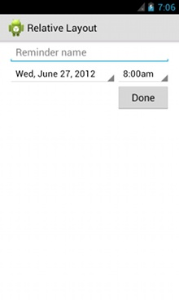
Output

Slide 62
Basic form Controls
TextView
EditText
Buttons
CheckBoxes
RadioButtons
Toggle Button
Spinner
SeekBar
RatingBar

Slide 63
TextView
<TextView android:id="@+id/lblSID"
android:layout_width="wrap_content"
android:layout_height="50dp"
android:layout_below="@id/adview"
android:text="SID : "
android:layout_alignParentLeft="true"
android:layout_margin="10dp"
/>

Slide 64
EditText
<EditText android:id="@+id/edit_message" android:layout_weight="1" android:layout_width="0dp" android:layout_height="wrap_content" android:hint="@string/edit_message" />
// TODO : have to explore the the input types .
android:inputType="textEmailAddress"

Slide 65
Button
Normal Button
Image Button
Left draw able / right draw able
<?xml version="1.0" encoding="utf-8"?><Button xmlns:android="http://schemas.android.com/apk/res/android" android:id="@+id/button_send" android:layout_width="wrap_content" android:layout_height="wrap_content"
android:text="@string/button_send" android:onClick="sendMessage" />
/** Called when the user touches the button */public void sendMessage(View view) { // Do something in response to button click}

Slide 66
Button click event
Button button = (Button) findViewById(R.id.button_send);
button.setOnClickListener(new View.OnClickListener() {
public void onClick(View v) {
// Do something in response to button click }});

Slide 67
CheckBoxes
<CheckBox android:id="@+id/checkbox_meat" android:layout_width="wrap_content" android:layout_height="wrap_content" android:text="@string/meat" android:onClick="onCheckboxClicked"/>
public void onCheckboxClicked(View view) {
// Is the view now checked?
boolean checked = ((CheckBox) view).isChecked();
// Check which checkbox was clicked
switch(view.getId()) {
case R.id.checkbox_meat:
if (checked) // Put some meat on the sandwich
  else // Remove the meat
break;
case R.id.checkbox_cheese:
If (checked) // Cheese me
      else // I'm lactose intolerant break;
// TODO: Veggie sandwich }}

Slide 68
Radio Buttons
<RadioGroup
android:layout_width="fill_parent"
android:layout_height="wrap_content"
android:orientation="vertical" >
<RadioButton
android:id="@+id/radio_pirates"
android:layout_width="wrap_content"
android:layout_height="wrap_content"
android:onClick="onRadioButtonClicked"
android:text="@string/pirates" />
<RadioButton
android:id="@+id/radio_ninjas"
android:layout_width="wrap_content"
android:layout_height="wrap_content"
android:onClick="onRadioButtonClicked"
android:text="@string/ninjas" />
</RadioGroup>

Slide 69
Click event listener
public void onRadioButtonClicked(View view) {
// Is the button now checked?
boolean checked = ((RadioButton) view).isChecked();
// Check which radio button was clicked
switch(view.getId()) {
case R.id.radio_pirates:
if (checked)
// Pirates are the best
break;
case R.id.radio_ninjas:
if (checked)
// Ninjas rule
break;
}}
}
}

Slide 70

Toggle Button
<ToggleButton android:id="@+id/togglebutton" android:layout_width="wrap_content" android:layout_height="wrap_content" android:textOn="Vibrate on" android:textOff="Vibrate off" android:onClick="onToggleClicked"/>

Slide 71
Detect Click event
public void onToggleClicked(View view) { // Is the toggle on?
boolean on = ((ToggleButton) view).isChecked();
if (on) { // Enable vibrate }
else {
// Disable vibrate
}
}

Slide 72
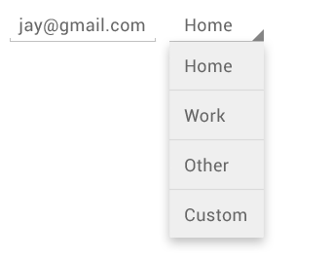
Spinner

Slide 73
layout XML
<Spinner android:id="@+id/planets_spinner" android:layout_width="fill_parent" android:layout_height="wrap_content" />

Slide 74
Resources
<resources>
<string-array name="planets_array"> <item>Mercury</item>
<item>Venus</item>
<item>Earth</item>
<item>Mars</item>
<item>Jupiter</item>
<item>Saturn</item>
<item>Uranus</item>
<item>Neptune</item>
</string-array>
</resources>

Slide 75
Populate Spinner from resources
Spinner spinner = (Spinner) findViewById(R.id.spinner);
// Create an ArrayAdapter using the string array and a default spinner layoutArrayAdapter<CharSequence> adapter = ArrayAdapter.createFromResource(this, R.array.planets_array, android.R.layout.simple_spinner_item);
// Specify the layout to use when the list of choices appearsadapter.setDropDownViewResource(android.R.layout.simple_spinner_dropdown_item);
// Apply the adapter to the spinnerspinner.setAdapter(adapter);

Slide 76
Explanations
The createFromResource() method allows you to create an ArrayAdapter from the string array. The third argument for this method is a layout resource that defines how the selected choice appears in the spinner control. The simple_spinner_item layout is provided by the platform and is the default layout you should use unless you'd like to define your own layout for the spinner's appearance.You should then call setDropDownViewResource(int) to specify the layout the adapter should use to display the list of spinner choices (simple_spinner_dropdown_item is another standard layout defined by the platform).

Slide 77
From Code
spinner2 = (Spinner) findViewById(R.id.spinner2);
List<String> list = new ArrayList<String>();
list.add("list 1");
list.add("list 2");
list.add("list 3");
ArrayAdapter<String> dataAdapter = new ArrayAdapter<String>(this,android.R.layout.simple_spinner_item, list);
dataAdapter.setDropDownViewResource(android.R.layout.simple_spinner_dropdown_item);
spinner2.setAdapter(dataAdapter);

Slide 78
OnItemSelectedListener
implements OnItemSelectedListener {
public void onItemSelected(AdapterView<?> parent, View view, int pos,long id)
{
Toast.makeText(parent.getContext(), "OnItemSelectedListener : " + parent.getItemAtPosition(pos).toString(),Toast.LENGTH_SHORT).show();
}
@Override public void onNothingSelected(AdapterView<?> arg0) {// TODO Auto-generated method stub }

Slide 79
SeekBar
<SeekBar
android:id="@+id/seekBar1"
android:layout_width="match_parent"
android:layout_height="wrap_content"
android:layout_alignParentLeft="true"
/>

Slide 80
Code
SeekBar sb = (SeekBar)findViewById(R.id.slider);sb.setMax(100);
sb.setProgress(50);
sb.setOnSeekBarChangeListener(this);

Slide 81
Event listener
@Override
public void onProgressChanged(SeekBar v, int progress, boolean isUser) {
TextView tv = (TextView)findViewById(R.id.percent);tv.setText(Integer.toString(progress)+"%");
}@Overridepublic void onStartTrackingTouch(SeekBar seekBar) {// TODO Auto-generated method stub}@Overridepublic void onStopTrackingTouch(SeekBar seekBar) {// TODO Auto-generated method stub}}

Slide 82
RatingBar
Layout XML
<RatingBar android:id="@+id/ratingBar"
android:layout_width="wrap_content" android:layout_height="wrap_content" android:numStars="4" android:stepSize="1.0" android:rating="2.0"
/>

Slide 83
EventListerners
ratingBar.setOnRatingBarChangeListener(new OnRatingBarChangeListener() {
public void onRatingChanged(RatingBar ratingBar, float rating,boolean fromUser) {
txtRatingValue.setText(String.valueOf(rating));
}

Slide 84
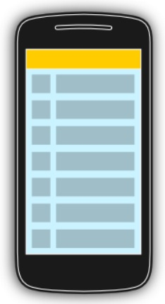

List
Normal List
List with multiple column

Slide 85
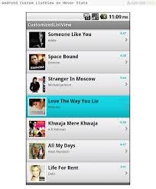
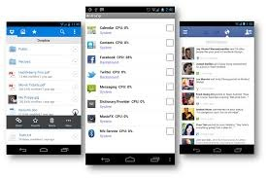
List Example

Slide 86
List Data
ListView
ListActivity
ListFragments

Slide 87
ListView
ListView is a view group that displays a list of scrollable items. The list items are automatically inserted to the list using an Adapter that pulls content from a source such as an array or database query and converts each item result into a view that's placed into the list.

Slide 88
XML
<ListView
android:id ="@+id/lstSimpleList"
android:layout_width="match_parent"
android:layout_height="match_parent"
></ListView>

Slide 89
Code
1# Create a adapter.
2# set the Adapter into a Lisview, that’s it !!!!
ArrayAdapter<String> datatHolder = new ArrayAdapter<String>(this,
android.R.layout.simple_expandable_list_item_1, prepareData());
lstSimpleList.setAdapter(datatHolder);

Slide 90
OnItemClick
lstSimpleList.setOnItemClickListener(new OnItemClickListener() {
@Override
public void onItemClick(AdapterView<?> list, View view, int position, long id) {
TextView clickedView = (TextView) view;
// list.getAdapter().getItem(position);
Toast.makeText(
SimpleList.this,
"Item with id [" + id + "] - Position [" + position + "] - Planet ["
+ clickedView.getText() + "]", Toast.LENGTH_SHORT).show();
}
});

Slide 91
Practice !!!!

Slide 92
ListActivity
We do not need to implement any Layout
Everything seems same as the normal ListView
to Get the List use getListView();
if want to change the List then use listView’s id as @android:id/list

Slide 93
See samples !!!!

Slide 94
New things to learn before moving forward.
Adapter
layout inflater
ArrayList

Slide 95
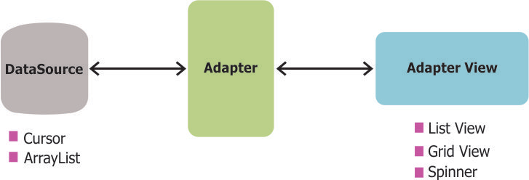
Adapters
Adapter in android are basically bridge between UI components and the datasource that fill data into UI Component.
Like Lists (UI Component) gets populated by using list adapter , from a datasource array.

Slide 96
Few important things about custom Adapters
You have to have a xml file for the each row
If you override ArrayAdapter<?> then you have to extend the getView method.
If you override BaseAdapter then you have to override some other methods too.
http://www.piwai.info/android-adapter-good-practices/

Slide 97
@Override
public int getCount() {
return bananaPhones.size();
}
// getItem(int) in Adapter returns Object but we can override
// it to BananaPhone thanks to Java return type covariance
@Override
public Object getItem(int position) {
return bananaPhones.get(position);
}
// getItemId() is often useless, I think this should be the default
// implementation in BaseAdapter
@Override
public long getItemId(int position) {
return position;
}
@Override
public View getView(int position, View convertView, ViewGroup parent) {
// Let's look at that later
}

Slide 98
LayoutInflater
While we are used to framework classes loading our layout resources for us, we can “inflate” a layout resource at any time using a LayoutInflater. This process reads in the XML, parses it, walks the element tree, creates Java objects for each of the elements, and stitches the results together into a parent-child relationship.

